Slide 1
Training Basics of NN
Course Code: CSC 4254
Course Title: Computer Vision & Pattern Recognition
Dept. of Computer Science
Faculty of Science and Technology
Lecture No: | 7 | Week No: | 4 | Semester:
Lecturer:

Slide 2

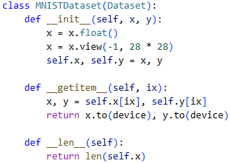
Steps of Training a NN
Derived Class of Dataset
Import the relevant packages
Build a dataset that can fetch one data point at a time
Wrapping the data loader (groups data)
Magic Methods
32 data points
Random 32
Assume, 90 data points;
Epoch1: 32, 32, 26
Epoch2: 32, 32, 26
Different combination

Slide 3
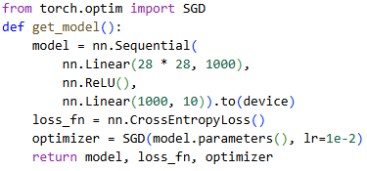
Steps of Training a NN
Flattening the images
4. Building the Model
Hidden Layers
Hidden Layer Activation
Output classes 10
Loss function for Categorical
Random Weights and Bias
Learning Rate .01

Slide 4

Steps of Training a NN
5. Define two functions to train and validate a batch of data, respectively
6. Define a function that will calculate the accuracy of the data
7. Perform weight updates based on each batch of data over increasing epochs
To Access Full Code, Click this button in slideshow

Slide 5
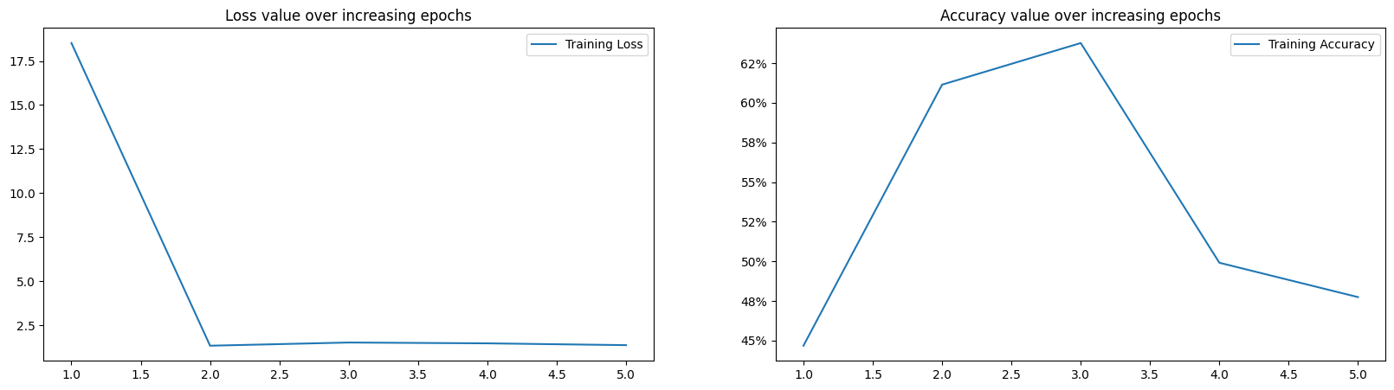
Finding of the Training

Slide 6
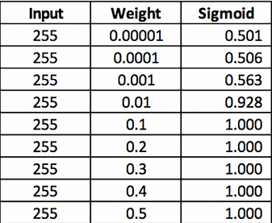
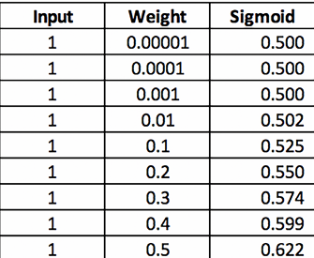
Scaling the Dataset
What is Data Scaling (Normalizing)?
Adjusting feature values to a similar range
Prevents large-value features from dominating
Why Scale Data?
Faster training
More stable gradients
Improves model performance
Data Without Scaling
Data With Scaling

Slide 7
Benefits of Scaling
To Access Full Code, Click this button in slideshow

Slide 8
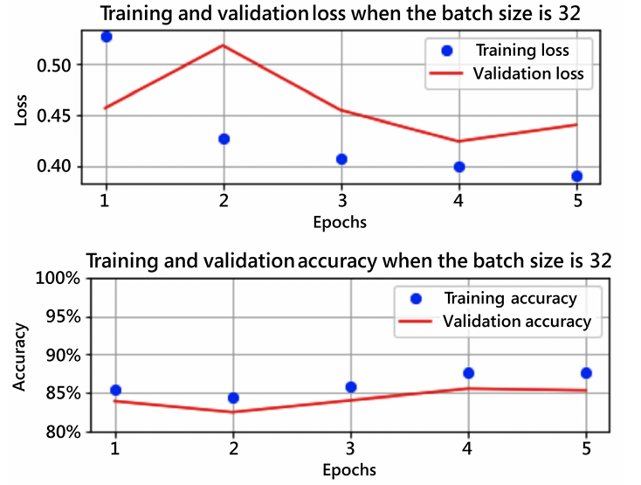
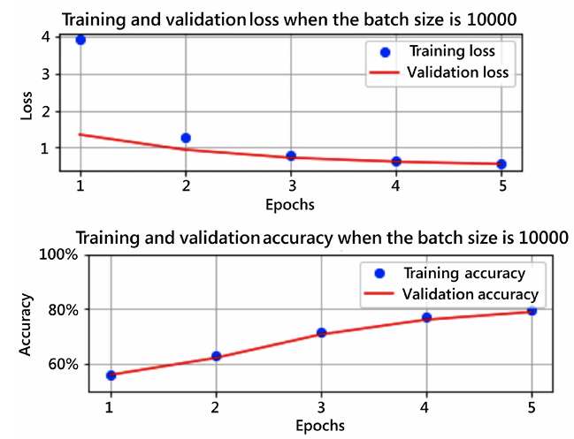
Varying the Batch Size
Here, we can see that the accuracy and loss values did not reach the same levels as that of the previous scenario, where the batch size was 32, because weights are updated fewer times per epoch (6 times) when compared to a batch size of 32 (1,875).

Slide 9
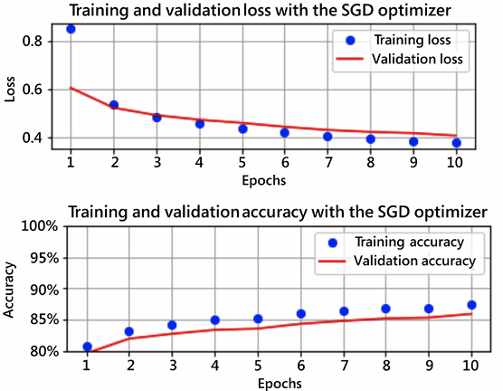
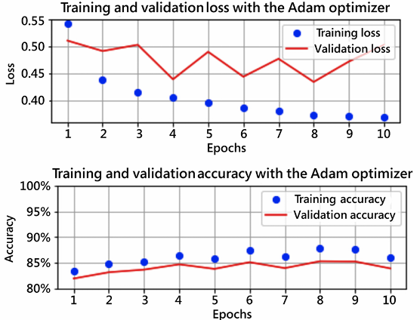
Varying the Loss Optimizer
Certain optimizers achieve optimal accuracy faster compared to others. Some of the other prominent optimizers that are available include Adagrad, Adadelta, AdamW, LBFGS, and RMSprop.

